Slide 1
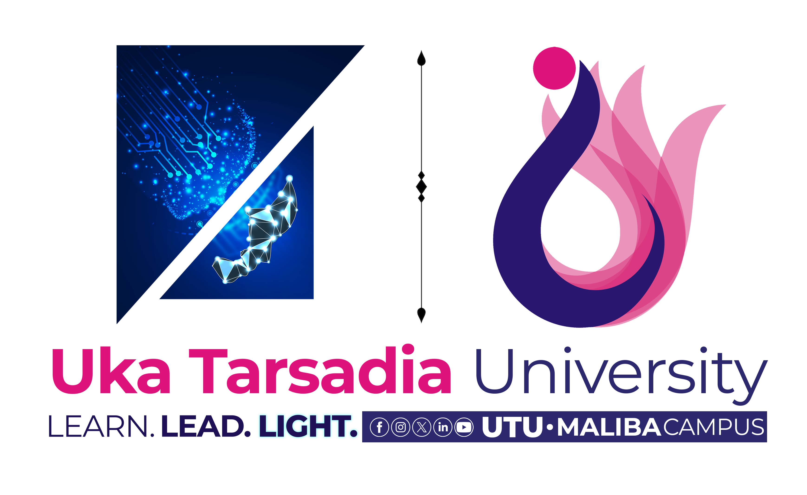
Unit – Authentication Methods, Passwords & Biometrics
Authentication Methods, Passwords & Biometrics
Know • Have • Are • Password Security • Password Attacks • Biometrics • MFA

Slide 2
Learning Objectives
Explain the three major authentication factors: something you know, have, and are.
Understand passwords, password verification and secure password storage.
Describe common password attacks at a conceptual level and the corresponding defenses.
Explain biometric authentication, its operation, advantages and limitations.
Compare authentication methods and understand multi-factor authentication (MFA).
Apply the concepts to practical login examples and exam questions.

Slide 3
Authentication — Definition
Authentication is the process of verifying that a person, device or service is really the entity it claims to be.
It answers the question: “Who are you?” or, more precisely, “Can you prove the claimed identity?”
Authentication is different from authorization. Authentication verifies identity; authorization decides what an authenticated user is allowed to do.
Example: entering a username identifies the claimed account; proving the password is correct authenticates the user; permissions then determine what the user can access.

Slide 4
Three Authentication Factors
Something You Know
Password • PIN • Passphrase
Something You Have
Security key • Token • Device
Something You Are
Fingerprint • Face • Iris
Authentication factors provide different kinds of evidence about the claimed user.
MFA: Using two or more independent factor categories reduces the risk that compromise of one factor alone is enough to gain access.

Slide 5
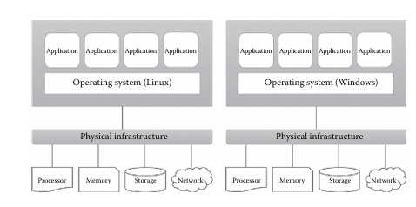
Factor 1 — Something You Know
This factor uses information that the user is expected to know.
Examples: password, PIN, passphrase, security answer or a memorized secret.
Advantages: inexpensive, easy to deploy and familiar to users.
Limitations: secrets can be guessed, disclosed, reused, phished or stolen.
Best practice: prefer long unique passwords/passphrases and combine knowledge factors with another factor when the risk justifies it.

Slide 6
Factor 2 — Something You Have
This factor uses possession of a physical or digital object controlled by the user.
Examples: hardware security key, smart card, authenticator app, registered phone or one-time-code token.
The security assumption is that the legitimate user possesses the registered authenticator.
Advantages: adds a second barrier even if a password is compromised.
Limitations: devices can be lost, stolen or unavailable; recovery procedures must be designed carefully.

Slide 7
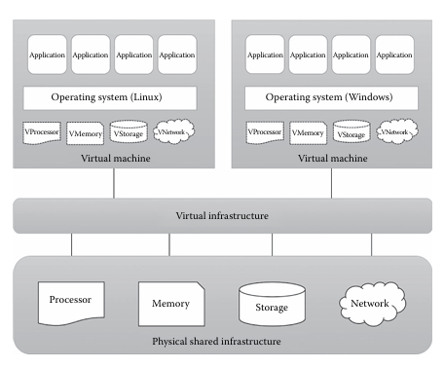
Factor 3 — Something You Are
This factor uses a measurable biological or behavioral characteristic.
Examples: fingerprint, face, iris and voice characteristics.
Biometrics are convenient because the characteristic is normally carried by the user.
However, a biometric is not a secret in the same way as a password; it cannot simply be replaced if compromised.
Biometric systems therefore require careful sensor, template-protection and fallback design.

Slide 8
Password — Definition & Characteristics
A password is a secret string used to authenticate a user.
A strong password is typically long, unique to the service and difficult for an attacker to predict.
Length generally matters greatly; passphrases can make strong secrets easier for people to remember.
Password reuse is dangerous because one compromised service can expose the same credential elsewhere.
Passwords should never be shared with colleagues or entered into suspicious pages.

Slide 9
Good Password vs Weak Password
Weak / Risky | Stronger Practice
123456 / password | Long passphrase or strong random password
Same password everywhere | Unique password for every important service
Short predictable pattern | Long, unpredictable secret
Written in shared/public place | Stored in a reputable password manager
Shared with others | Kept private; use account delegation when needed
Remember: Length, uniqueness and secrecy are central to password security.

Slide 10
Password Verification — Basic Process
Server retrieves
stored verifier + salt
and KDF parameters
User enters
username + password
Recompute verifier
Compare
Match → authenticate
No match → reject
Important: The server should verify a derived password value; it should not need to know the user's plaintext password.

Slide 11
How Passwords Should Be Stored
A secure system should not store users' plaintext passwords.
During enrollment, the password is processed by a password hashing/KDF mechanism and the resulting verifier is stored.
During login, the entered password is processed using the stored parameters and compared with the stored verifier.
Modern password-storage schemes are intentionally expensive and include a unique salt to make large-scale guessing harder.
Examples of password KDF families include Argon2, scrypt and bcrypt; the exact choice should follow current security guidance.

Slide 12
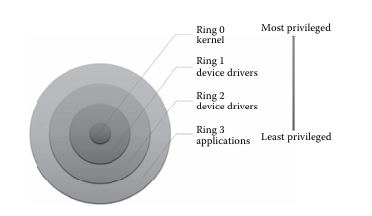
Salt — Why It Is Important
A salt is a unique random value stored with each password verifier.
The salt makes identical passwords produce different stored results when processed by a suitable password-hashing scheme.
Salts help defeat precomputed lookup/rainbow-table approaches and reduce the value of reusing one precomputed table across many accounts.
A salt is not a password and does not need to be kept secret.
Important: salting alone is not enough; use a dedicated password hashing/KDF function with appropriate work factors.

Slide 13
Password Verification Example
Salt + password
→ password KDF
Password
entered
Derived verifier
Compare
Example: If the entered password is correct, the same salt and KDF settings produce the expected verifier. Otherwise the values differ.
Never compare or store plaintext passwords as the normal verification method.

Slide 14
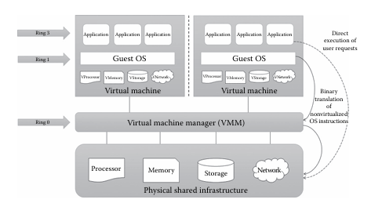
Attacking Systems via Passwords — Overview
Password attacks try to obtain valid credentials or exploit weak password practices.
Common categories include guessing, credential stuffing, password spraying, phishing/social engineering, malware/keylogging and offline cracking of stolen password verifiers.
Some attacks target users; others target the authentication system or a stolen credential database.
Defensive design should assume that passwords can eventually be exposed and should limit the damage through MFA, rate limiting, secure storage and monitoring.
Security education is important because users are often targeted through deception rather than purely technical attacks.

Slide 15
Guessing & Brute-Force Attacks
Guessing tries likely passwords based on common choices, personal patterns or previously exposed credentials.
Brute force systematically explores possible password combinations; its cost grows rapidly as password length and character uncertainty increase.
Rate limiting, account lockout controls used carefully, MFA and strong password policies can reduce online guessing risk.
Offline guessing is different: if an attacker steals password verifiers, they can test guesses without contacting the original login system.
Dedicated password KDFs slow offline guessing by making each candidate expensive to test.

Slide 16
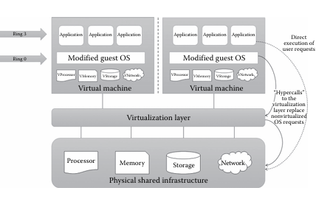
Credential Stuffing & Password Spraying
Credential stuffing reuses username/password pairs obtained from another breach against different services.
Password spraying tries a small set of common passwords across many accounts instead of many guesses against one account.
Both attacks exploit password reuse or predictable passwords.
Defenses include unique passwords, MFA, breached-password screening, rate controls, anomaly detection and user awareness.
Teaching point: an organization cannot control another website's breach, but it can reduce the effect of reused credentials.

Slide 17
Phishing & Social Engineering
Phishing tricks a user into revealing a password or approving an authentication request.
Attackers may imitate trusted brands, create urgent messages or direct users to fraudulent login pages.
Technical controls can help, but user awareness and phishing-resistant authentication are especially valuable.
Check the destination, unexpected requests and unusual urgency before authenticating.
Hardware security keys using phishing-resistant standards can provide stronger protection than passwords and many one-time codes.

Slide 18
Password Attack → Defense Mapping
Threat | What it exploits | Useful defenses
Guessing / brute force | Weak or short secrets | Long unique passwords, rate limits, MFA
Credential stuffing | Password reuse | Unique passwords, MFA, breached-password screening
Password spraying | Common passwords across many accounts | MFA, monitoring, rate controls
Phishing | Human trust / deceptive login | User awareness, phishing-resistant MFA
Stolen verifiers | Weak password storage | Salted password KDF, strong parameters
Defensive principle: Reduce both the probability of compromise and the damage when one factor is lost.

Slide 19
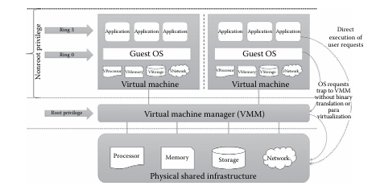
Biometrics — Definition
Biometric authentication identifies or verifies a person using measurable biological or behavioral characteristics.
Common modalities include fingerprint, face, iris and voice.
A biometric system normally captures a sample, extracts distinctive features and compares them with a stored reference template.
Biometrics are usually used for convenience and local device unlocking, often together with another authentication factor.
The system must balance false matches, false rejections, usability, privacy and security.

Slide 20
Biometric Authentication Process
Capture sample
+ quality check
Feature extraction
→ template
Biometric
sensor
Compare
+ threshold
Enrollment stores a protected reference; verification compares a new sample with that reference.
Security note: A biometric template should be protected because biometric characteristics are difficult or impossible to replace after compromise.

Slide 21
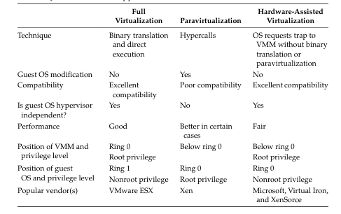
Biometric Performance — FAR & FRR
False Acceptance Rate (FAR): probability that an unauthorized person is incorrectly accepted.
False Rejection Rate (FRR): probability that an authorized person is incorrectly rejected.
Changing the decision threshold can change the trade-off between FAR and FRR.
High security often requires reducing false acceptance, but an excessively strict system can frustrate legitimate users.
Real systems must also consider presentation attacks, sensor quality, environmental conditions and demographic performance differences.

Slide 22
Biometric Examples — Advantages & Limitations
Modality | Advantages | Limitations
Fingerprint | Fast, common, convenient | Sensor quality, worn/dirty fingers
Face | Contactless, convenient | Lighting, pose, spoofing/presentation attacks
Iris | Distinctive, accurate | Specialized capture and usability considerations
Voice | Natural for remote interaction | Noise, illness, replay/spoofing concerns
Remember: No biometric is perfect; the system must manage both security and user experience.

Slide 23
Multi-Factor Authentication (MFA)
Authenticator / key
HAVE
Password
KNOW
Biometric
ARE
Access
MFA = two or more independent authentication factors
Example: Password + security key is MFA because the factors come from different categories: know + have.

Slide 24
Authentication Methods — Comparison
Method | Factor | Main strength | Main limitation
Password | Know | Cheap and familiar | Can be guessed, phished or reused
Security key / token | Have | Strong additional barrier; can be phishing-resistant | Can be lost; recovery needed
Biometric | Are | Convenient and hard to forget | Cannot be changed like a password
MFA | 2+ factors | Layered protection | More setup and recovery complexity
Best practice: For important accounts, use MFA and choose phishing-resistant options when practical.

Slide 25
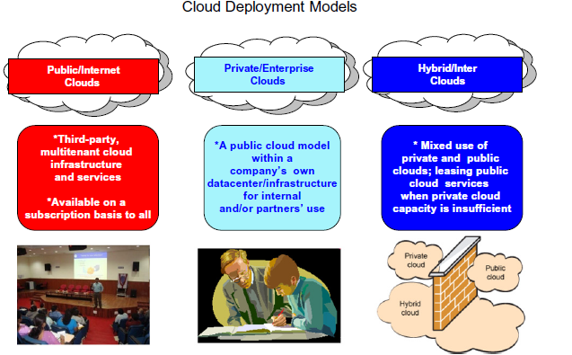
Real-Life Example — Online Banking
Step 1: User enters username and password — something they know.
Step 2: User approves a strong authentication method or uses a registered authenticator — something they have.
Step 3: The bank checks the authentication result and applies authorization rules.
If the password is stolen, the additional factor can prevent the attacker from completing the login.
For high-risk actions, the bank may require stronger or step-up authentication.

Slide 26
Important Exam Points
Authentication verifies identity; authorization controls access after identity is established.
Something you know = password/PIN; something you have = token/security key/registered device; something you are = biometric.
Passwords should be stored using a dedicated password hashing/KDF mechanism, not plaintext.
Salts are unique per credential and are normally stored with the password verifier.
Credential stuffing uses reused credentials; password spraying uses a small set of guesses across many accounts.
Biometric systems have FAR and FRR trade-offs and require secure template handling.

Slide 27
Exam Questions — Short Answers
Q1. What are the three authentication factors? — Know, have and are.
Q2. Why should passwords not be stored in plaintext? — A database compromise would directly expose every password.
Q3. What is credential stuffing? — Reusing credentials leaked from one service to attempt access to another.
Q4. What is FAR? — The rate at which unauthorized users are incorrectly accepted.
Q5. What is FRR? — The rate at which legitimate users are incorrectly rejected.
Q6. Why is MFA stronger than password-only authentication? — It requires independent evidence from another factor.

Slide 28
Quick Revision
Authentication → verify identity.
Authorization → decide permissions.
Know → password/PIN | Have → token/security key/device | Are → biometric.
Password storage → unique salt + suitable password KDF.
Major password threats → guessing, brute force, stuffing, spraying, phishing and stolen verifiers.
Biometrics → convenient, but not a secret; protect templates and provide secure recovery.
MFA → combine independent factors to reduce single-factor compromise.

Slide 29
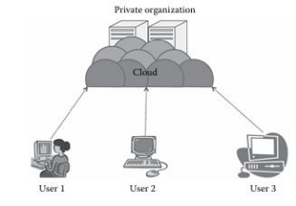
Unit Summary
Authentication is a foundational security control for proving identity.
The three factor categories are knowledge, possession and inherence.
Password security depends on strong user secrets, secure verification and resistance to online and offline attacks.
Biometrics can improve convenience but introduce accuracy, privacy and recovery considerations.
MFA provides layered protection by combining different authentication factors.
Good authentication design considers both technical attacks and human behavior.

Slide 30
Thank You
Thank You
Questions / Discussion
Final thought: Strong authentication combines secure technology, good user practices and multiple independent layers of protection.

